Slide 1

Advance Database Programming

Slide 2
Stored Procedure
Syntax:
CREATE PROCEDURE <procedure_name>
[@parameter1 data_type, @parameter2 data_type…] AS BEGIN /* SQL Statements. */ END
GO
Example:
CREATE PROCEDURE usp_SelectAllEmployee
AS
BEGIN
SELECT * FROM Employee
END
GO
Notes:
2

Slide 3
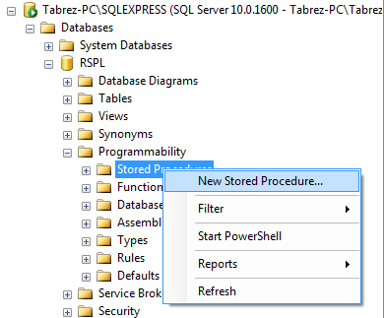
Stored Procedure
How to create Stored Procedure?
To create stored procedure right click on ‘Stored Procedure’ folder under ‘Programmability’ folder and choose ‘New Stored Procedure…’ option as shown in above figure.
Notes:
3

Slide 4
View
In SQL, a view is a virtual table based on the result-set of an SQL statement.
A view contains rows and columns, just like a real table. The fields in a view are fields from one or more real tables in the database.
You can add SQL functions, WHERE, and JOIN statements to a view and present the data as if the data were coming from one single table.
Syntax:
CREATE [OR REPLACE] VIEW view_name AS SELECT column_name(s) FROM table_name WHERE condition
Example:
CREATE VIEW [Employee_List] AS SELECT EmployeeID,FirstName,LastName FROM Employee WHERE Salary > 5000
We can query the view above as follows:
SELECT * FROM [Employee_List]
Notes:
4

Slide 5
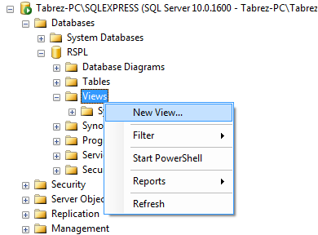
How to create view?
Step 1:
To create view right click on ‘Views’ folder under database and choose ‘New View…’ option as shown in above figure.
Notes:
5

Slide 6
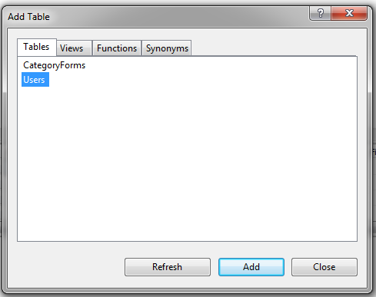
How to create view?
Step 2:
Once you click on ‘New View…’ option you will have a dialogbox with list of Tables, choose table for which you want to create view and add it in query builder by click on Add button and close it as shown in above figure.
Notes:
6

Slide 7
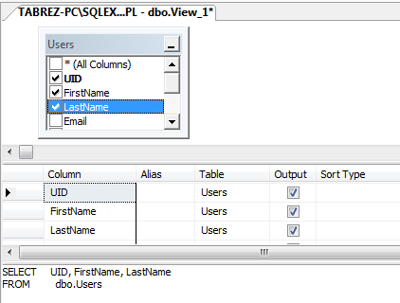
How to create view?
Step 3:
Once you close ‘Add Table’ dialog box you will see your selected table added in query builder, corresponding query in SQL Pane (i.e. last row) and you can update it as shown in above figure.
After creating query to save view press Ctrl+S and give view name and save it you will see created view under ‘View’ folder.
Notes:
7

Slide 8
User-Defined Function
Types of UDF:
Scalar function
Return a single value.
In Line Table function
Return a single table variable that was created by a select statement.
Multi-statement Table function
Returns a table variable whose structure was created by hand, similar to a Create Table statement.
Notes:
8

Slide 9
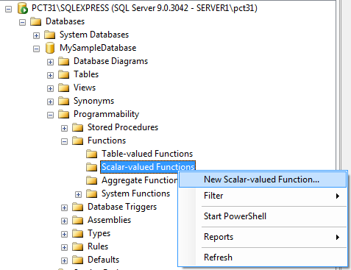
Type of UDF
1. Scalar Function
To add new scalar function right click on 'Scalar-valued Functions' under 'Functions' folder and choose 'New Scalar-valued Function...' option as shown in above figure. You will see the scalar function's syntax in SQL pane beside object explorer, update it as per need and save it by pressing Ctrl+S and give function name when ask to save.
Notes:
9

Slide 10
Type of UDF
1. Scalar Function
Example:
CREATE FUNCTION dbo.DateOnly(@InDateTime datetime)
RETURNS varchar(10)
AS
BEGIN
DECLARE @MyOutput varchar(10)
SET @MyOutput = CONVERT(varchar(10),@InDateTime,101)
RETURN @MyOutput
END
To call function:
SELECT dbo.DateOnly(GETDATE())
Above function takes full date and time as parameter and returns only date in varchar datatype.
Notes:
10

Slide 11
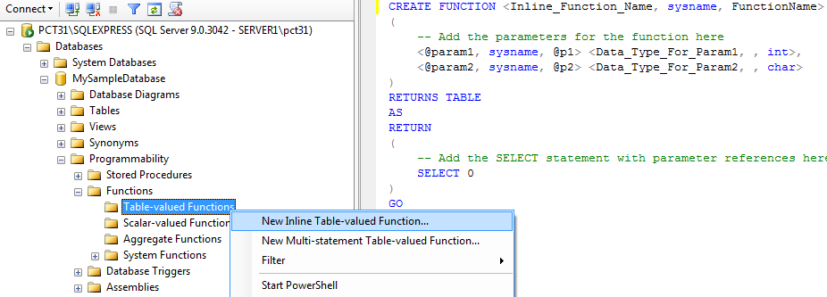
Type of UDF
2. In-line Table Function
To add new In-line Table function right click on 'Table-valued Functions' under 'Functions' folder and choose 'New Inline Table-valued Function...' option as shown in above figure. You will see the Inline function's syntax in SQL pane beside object explorer, update it as per need and save. You will see the created function under 'Table-valued Functions' folder.
Notes:
11

Slide 12
Type of UDF
2. Inline Table Function
Example:
CREATE FUNCTION dbo.LookByFName(@FirstLetter char(1))
RETURNS TABLE
AS
BEGIN
RETURN (SELECT *
FROM employee
WHERE LEFT(fname, 1) = @FirstLetter)
END
To call function:
SELECT * FROM dbo.LookByFName('A')
Above function returns all the employee whose first name start with a character 'A'.
Notes:
12

Slide 13
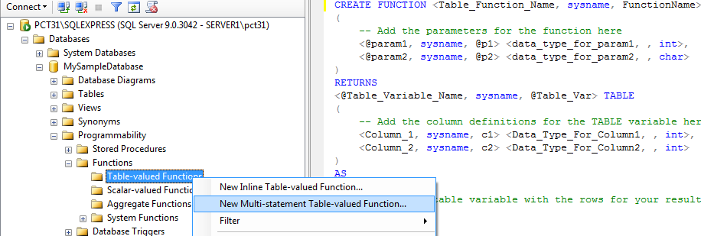
Type of UDF
3. Multi-Statement Table Function
To add new multi-statement Table function right click on 'Table-valued Functions' under 'Functions' folder and choose 'New Multi-statement Table-valued Function...' option as shown in above figure. You will see the function's syntax in SQL pane beside object explorer, update it as per need and save. You will see the created function under 'Table-valued Functions' folder.
Notes:
13

Slide 14
Type of UDF
3. Multi-statement Table Function
Example:
CREATE FUNCTION dbo.multi_test(@FirstLetter char(1))
RETURNS @Result TABLE
(fname varchar(20), hire_date datetime,on_probation char(1))
AS
BEGIN
INSERT INTO @Result (fname, hire_date)
SELECT fname, hire_date FROM employee
WHERE LEFT(fname, 1) = @FirstLetter
UPDATE @Result SET on_probation = 'N'
UPDATE @Result SET on_probation = 'Y' WHERE hire_date < '01/01/1991'
RETURN
END
To call function:
SELECT * FROM dbo.multi_test('A')
Notes:
14

Slide 15
Cursor
Syntax:
DECLARE CursorName CURSOR READ_ONLY FORWARD_ONLY LOCAL FOR SELECT ColumnName FROM TableName OPEN CursorName FETCH NEXT FROM CursorName INTO @Variable WHILE @@FETCH_STATUS <> -1 BEGIN <Your part of code for the success condition> FETCH NEXT FROM CursorName INTO @Variable END CLOSE CursorName DEALLOCATE CursorName
(Note: Cursor can be created in stored procedure)
Notes:
15

Slide 16
Cursor
Example:
/* Create two variables that would store the values returned by the fetch statement */
DECLARE @DepartmentName char(25) DECLARE @DepartmentHead char(25) /* Define the cursor that can be used to access the records of the table,row by row */
DECLARE curDepartment cursor for SELECT vDepartmentName,vDepartmentHead from Department -- Open the cursor
OPEN curDepartment -- Fetch the rows into variables
FETCH curDepartment into @DepartmentName,@DepartmentHead
(Continue...)
Notes:
16

Slide 17
Cursor
Example:
--Start a loop to display all the rows of the cursor WHILE(@@fetch_status=0) BEGIN Print 'Department Name =' + @DepartmentName Print 'Department Head =' + @DepartmentHead --Fetch the next row from the cursor FETCH curDepartment into @DepartmentName,@DepartmentHead END -- Close the cursor CLOSE curDepartment -- Deallocate the cursor DEALLOCATE curDepartment
Notes:
17

Slide 18
Reference link
1. Database, Table, Sql Statement,View
1. http://www.cl500.net/index.html
2. http://blog.sqlauthority.com/best_top_sql_server_blog_all_post/
3. http://msdn.microsoft.com/en-us/library/ms186312.aspx
4. http://www.mrbool.com/articles/viewcomp.asp?comp=4672
5. http://www.globalguideline.com/sql/What_Is_SQL_Table.php
6. http://www.w3schools.com/sql/sql_select.asp
2. Function
1.http://chiragrdarji.wordpress.com/2007/04/17/
difference-between-user-defined-function-and-stored-procedure/
2. http://www.dotnetspider.com/resources/
19189-Difference-Chart-User-Defined-Function-UDF.aspx
3. Cursor
1. http://msdn.microsoft.com/en-us/library/ms191179.aspx
4. Index
1. http://www.dotnetspark.com/kb/1957-indexex-sql-server.aspx
2. http://www.codeproject.com/KB/database/Define_Index_in_SQLServer.aspx
Notes:
18

Slide 19
Reference link
5. Join
1. http://programming.top54u.com/post/Types-of-Joins-in-Sql-Server-2005.aspx
6. Back Up Database
1. http://msdn.microsoft.com/en-us/library/ms187510.aspx
7. Restore a Database
1. http://msdn.microsoft.com/en-us/library/ms177429.aspx
Notes:
19

Slide 20
Advance Database Programming
THANK YOU
ANY QUESTIONS ?
Notes:
20
20

